Slide 1


STUDENT TEACHER PORTAL SYSTEM
Prepared by:
Ayat Maryam L1F25BSSC0098
Awais Zafar L1F25BSSC0021
Abdul Rehman Chishti L1F25BSSC0004
Sharjeel Ahmad L1F25BSSC0016

Slide 2



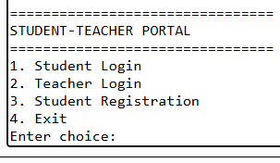
CONSOLE BASED PROGRAM
LOGIC BEHIND EVERY CLICK

Slide 3

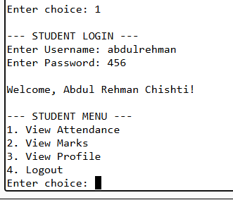
STUDENT LOGIN
DIVIDING ROLES TO BUILD EFFICIENTLY
Student can:
View Attendence
View Marks
View Profile

Slide 4

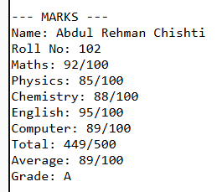
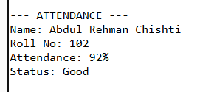
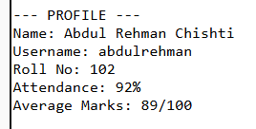

STUDENT ACCESS
Marks
Profile
Attendence

Slide 5
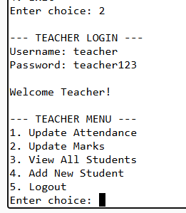

TEACHER LOGIN
Teacher can:
UpdateAttendence
Update Marks
View All Students
Add New Student

Slide 6

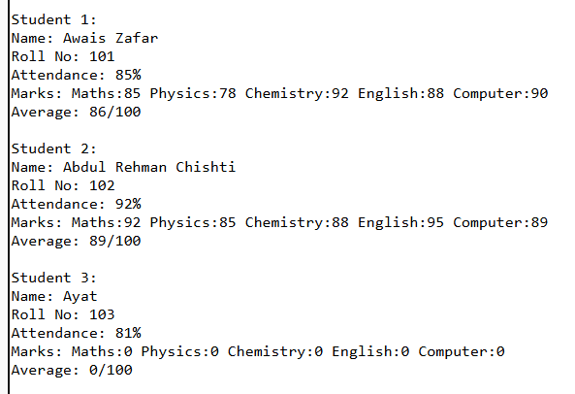
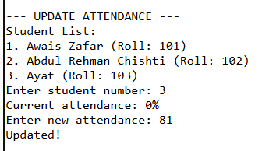
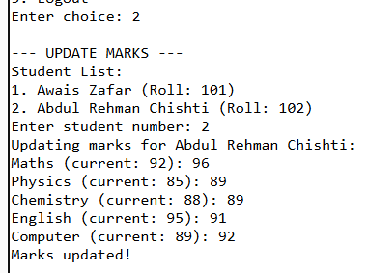
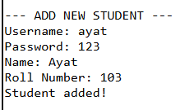
TEACHER ACCESS
Following Operations can be
Performed by Teacher
View All Students
Update Attendence
Update Marks
Add New Student

Slide 7

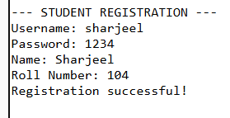
SUDENT REGISTRATION
STUDENT CAN BE REGISTERD DIRETLY

Slide 8

ADVANTAGES
Simple & Beginner-Friendly
Efficient Memory Usage
Fast Execution
Data Persistence (Within Session)
User-Friendly Interface
Security Features
Scalable Structure

Slide 9


WE CAN ADD ALOT OF FUNCTIONS ACCORDING TO REQUIREMENT
FUTURE ADVANCEMENTS
Add File Storage - Save data to text/binary files
Use Structures/Classes - Better data organization
Implement Input Validation - Prevent crashes
Add Multiple Teachers - Teacher management system
Include Search Features - By name, roll number, etc.
Add Data Export - Generate reports
Implement Password Hashing - Basic security
Create Backup System - Prevent data loss

Slide 10

THANK YOU
Our Team
Ayat Maryam L1F25BSSC0098
Awais Zafar L1F25BSSC0021
Abdul Rehman Chishti L1F25BSSC0004
Sharjeel Ahmad L1F25BSSC0016

